Slide 1
Student Orientation
2024

Slide 2
Welcome!
Mount Nittany Health is proud of the care and service provided to our patients and our community, and we’re pleased to share our expertise and resources by educating the healthcare providers of the future.

Slide 3
Welcome!
This orientation will provide you with information regarding:
Student expectations
Policies and procedures
Patient safety
Confidentiality

Slide 4
Computer Access
Throughout this orientation presentation, you will be asked to read linked documents and policies.
In order to view these documents and policies, you will need to access Connect, the Mount Nittany Health intranet portal.

Slide 5
Computer Access
Let’s start by logging into the network and changing your password.
Please go to https://apps.mountnittany.org.
Enter the username and temporary password that was
provided to you by your instructor.
Change your password. Make sure it contains:
At least 8 characters
A capital letter
Either a number or special character
No part of your name

Slide 6
Computer Access
Once you have changed your password, please go to https://portal.mountnittany.org.
Enter your username and new password.
This will allow you to access the Connect page.
Leave Connect open while you view the rest of this orientation presentation. As you click on each linked document and policy throughout this presentation, the document or policy will open through Connect.

Slide 7
Logging your Hours
You must sign in and out of Volgistics every time you are here as a student. You will receive your Volgistics PIN from the student coordinator or your instructor.

Slide 8
Logging your Hours
There are 3 ways to access Volgistics:
Use the iPad that is located on the basement floor of the medical center, near the student lockers.
Log onto a Mount Nittany Health computer and access
Connect.
Use a link on your phone that may be provided by your instructor.

Slide 9
Logging your Hours
Tracking your hours allows us to:
Know who is on-site at a particular time in case of emergency.
Identify who may have interacted with certain patients at a particular time.
Quantify and report student experiences as a benefit to the community.
Provide a record of your completed student hours to you or your instructor as requested.

Slide 10
Parking
When arriving at Mount Nittany Medical Center, please park in the back of Lot C or in the back of any employee lot. Do not park in any employee or visitor lot.
We will issue you a student ID badge and parking pass. Please hang your parking pass from your rearview mirror.
Lot C

Slide 11
Student ID Badge
You must wear your Mount Nittany Health student ID badge at all times when you are here.
Please wear your ID badge on your chest so others
can see it clearly.

Slide 12
Student ID Badge
Never leave your badge unsecured, as it is programmed with access to certain doors at the hospital and could pose a security risk if lost. If you lose your badge, immediately tell your instructor and notify us at 814.234.6187. We will deactivate that badge and issue you a new one. Replacement badges cost $10 each.
Your badge must be returned to us at the end of your student experience.
Please review our ID badge policy.

Slide 13
Personal Belongings
Please do not bring your belongings onto the clinical units.
You may secure your belongings in a locker on the
basement floor of Mount Nittany Medical Center. Just remember to:
Bring your own padlock
Empty your belongings at the end of each day

Slide 14
Professionalism
Take pride in your journey to become a healthcare professional.
Keep conversations appropriate,
quiet, and related to patient care.
Do not bring your phone with you to clinicals, unless you need it for emergency purposes and have cleared it with your instructor.
Do not congregate in the staff work stations or patient care areas.

Slide 15
Professionalism
Remember to introduce yourself to each patient for whom you provide care:
Who you are
What type of student you are
What school you are from
Your role in the patient’s care
“Hi! My name is Lindsay, and I am a nursing student from CPI. I’m working with your RN, Lucy, today.”

Slide 16
Professionalism
During any clinical free time (if you are caught up on your patient care and documentation), please consider emptying patient trash cans and dirty linen hampers, offering assistance to staff, or tidying work stations or patient care areas.
Teamwork is an essential part of the nursing profession, and good student habits will carry over into your professional career.

Slide 17
Professionalism
The quality of your experience depends on you! To get the most out of your experience, engage with various members of the healthcare team and seek out opportunities for learning.

Slide 18
Communication
Communication is an important part of delivering safe, effective healthcare.
Communicate your scope of practice and responsibilities to staff. Never perform any skills outside of your scope of practice.
***Please note that students and faculty are not allowed to use the tube system at MNMC.
If you ever have a question about your responsibilities or scope of practice, contact your clinical instructor.

Slide 19
Communication
Be sure to report any necessary information to staff as needed and at the end of your shifts:
Abnormal findings
Care provided
Unfinished work

Slide 20
Student Health
We take the health and safety of students and faculty seriously.
Please review the health policy and the Respectful Treatment of Students policy.

Slide 21
Patient Safety
Report any situation or event that could compromise patient safety.
If necessary, work with your instructor to complete an
electronic event report through Connect.
Reporting information can be found on pages 2 and 10
of the student orientation handbook.

Slide 22
Patient Safety
Do not use banned abbreviations when documenting.
Information can be found on pages 2-3 of the student
orientation handbook.
Please review policy I.D.2.11: Patient’s Medical Record and Documentation.

Slide 23
Patient Safety
Use proper body mechanics and appropriate lift equipment when moving or transferring patients. Please review policy.
Dispose of waste properly and place dirty linens in appropriate hampers.
Dispose of documents containing protected health
information in shredder bins.
Report any equipment malfunctions to staff or your instructor.

Slide 24
Patient Safety
Handle sharps carefully and dispose of sharps properly. Please review policy. If you experience a sharps injury or blood exposure, immediately wash the affected area with soap and water and report to your instructor.
Handle oxygen cylinders safely and store properly according to policy.

Slide 25
Patient Safety
Prevent patient falls:
Keep beds in low position
Keep rooms clear of obstacles
Observe fall risk based on colored socks
RED socks = HIGH fall risk
GREEN socks = LOW fall risk
Please review policy.
See also page 7 of the student handbook.

Slide 26
Patient Safety
Practice standard precautions and good hand hygiene with all patients.
Please review policy.

Slide 27
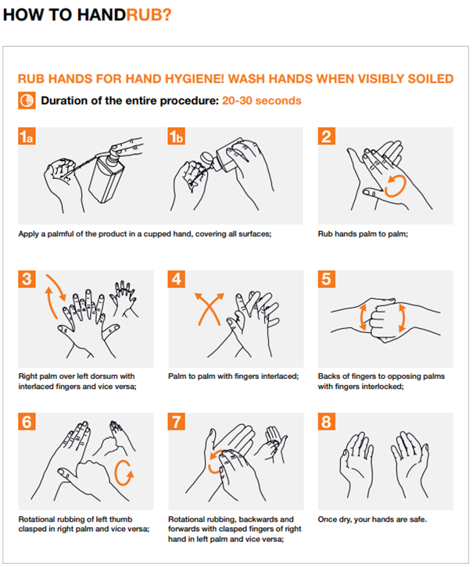
Hand Hygiene – Infection Control
Hi! Welcome to Mount Nittany Medical Center. We hope you enjoy your time here.
We are the Infection Prevention and Control nurses, and we want to educate you on Hand Hygiene practices while you are with us. Since you are responsible for patient care and/or are touching the patient environment, assigned staff will be observing your hand hygiene compliance.
Hand Hygiene is way of cleaning your hands to reduce potential pathogens. Hand hygiene is the single most important procedure for the prevention of healthcare-associated infections. Reference Policy #401, Hand Hygiene.
Types of Hand Hygiene:
Handwashing: A vigorous, brief rubbing together of all surfaces of hands lathered with plain soap for at least 15 seconds, followed by rinsing under a stream of water.
Wash with soap and water when visibly dirty or contaminated or when providing care to a patient with a spore-forming bacteria such as C. difficile
Antiseptic Hand Rub: The application of an antiseptic hand-rub product to all surfaces of the hands for at least 15 seconds to reduce the number of micro-organisms present.
Hand sanitizer is the recommended method
Duration of entire hand rub procedure should be 20-30 seconds
When visibly soiled and after caring for patients with C.difficile, hands should be washed, not rubbed
Pay special attention to backs of hands, fingertips/fingernails, thumbs, and between fingers

Slide 28
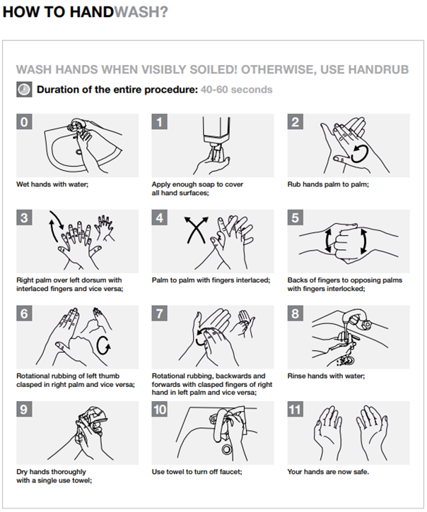
Hand Hygiene – Continued
Duration of entire handwashing procedure should be 40-60 seconds
Pay special attention to backs of hands, fingertips/fingernails, thumbs, and between fingers

Slide 29
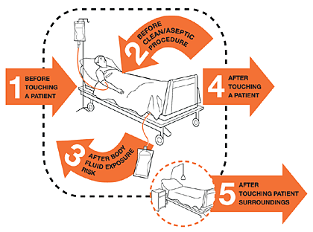
Hand Hygiene – Continued
We follow the World Health Organization’s 5 Moments for Hand Hygiene approach for when to complete Hand Hygiene.
These are the indications that you will be assessed for compliance in.
For example, you arrive at a patient room to take patient to a test.
You should complete hand hygiene prior to touching the patient. You should also complete
hand hygiene after touching patient, before touching the wheelchair to transport the patient.
Gloves and Hand Hygiene
Gloves are not a substitute for hand hygiene
If your task requires gloves, perform hand hygiene prior to donning gloves, before touching the patient, or the patient environment.
Perform hand hygiene immediately after removing gloves
Thank you!
Taylor Kopp BSN, RN, CIC
Kara Brenneman BSN, RN, CIC
814-234-6164

Slide 30
Patient Safety
Mount Nittany Health utilizes infection prevention and control procedures to prevent the spread of infectious diseases.
Please review policy.
Look for posted signage on patient room doors.

Slide 31
Patient Safety
Used for patients with infections that can be spread on hands or surfaces:
MRSA, hepatitis A, ringworm, etc.
Caregivers must wear:
Gown
Gloves
Please review policy.

Slide 32
Patient Safety
Used for patients with infections that can be spread via spores on hands or surfaces:
C. diff.
Caregivers must wear:
Gown
Gloves
Must wash hands with soap and water, not sanitizer.

Slide 33
Patient Safety
Used for patients with infections that can be spread via respiratory droplets:
Influenza, pertussis, etc.
Caregivers must wear:
Gown
Gloves
Procedure mask
Please review policy.

Slide 34
Patient Safety
Used for patients with infections that can be spread via aerosolized respiratory droplets:
Measles, TB, etc.
Caregivers must wear:
Gown
Gloves
Fitted respirator
Students and faculty are not permitted to care for patients under airborne precautions.
Please review policy.

Slide 35
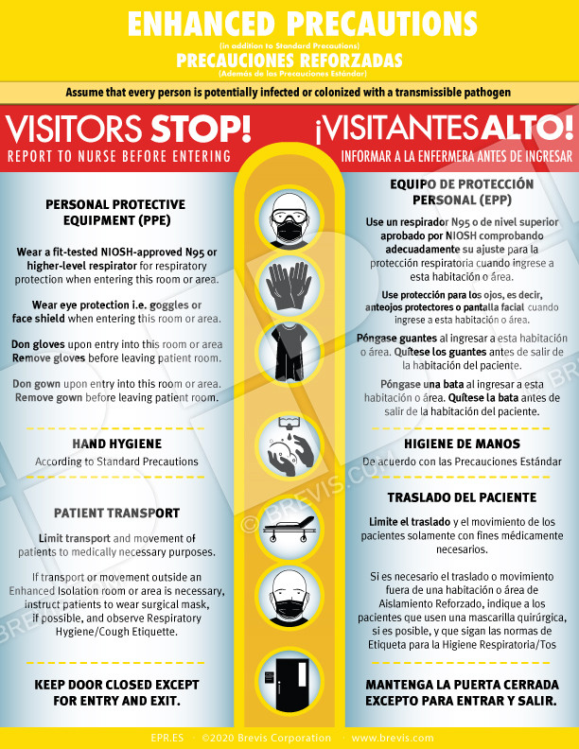
Patient Safety
Used for patients with COVID-19.
Caregivers must wear:
Gown
Gloves
Fitted respirator
Students and faculty are not permitted to care for patients with COVID-19.
Please review policy.

Slide 36
COVID-19 Guidelines – Vaccination:
Documentation of receipt of COVID-19 immunization (volunteers, students and faculty only) – proof of COVID-19 vaccination. Volunteers, students and faculty are encouraged to stay up-to-date with their COVID-19 vaccines in accordance with CDC recommendations at:
Stay Up to Date with COVID-19 Vaccines | CDC
Any new volunteer, student and/or faculty member, prior to commencement of their relationship with MNH will be required to provide proof of COVID-19 vaccination status or provide a declination.

Slide 37
COVID-19 Guidelines - Masking:
Masking: Masking is no longer required except under the following circumstances:
Providing care to a COVID-19 positive patient
Providing care to a PUI patient
Per patient request
Etiquette for respiratory symptoms
Increases in internal and local COVID-19 activity
Please refer to the updated COVID-19 mitigation strategies in the Disease Specific Infection Prevention & Control Isolation Guidelines HERE. *Note: When caring for a suspected or confirmed COVID-19 positive patient, full PPE is still required: NIOSH-approved N95 or higher-level respirator, gown, gloves, and eye protection.

Slide 38
COVID-19 Guidelines
We will continue to provide masks for anyone who wishes to wear one.
Patients and visitors will NOT be required to mask except when symptomatic, positive COVID or PUI.
In accordance with CDC guidelines, all students/faculty must monitor themselves for symptoms of COVID-19 and only report to Mount Nittany Health for educational experiences if symptom-free.

Slide 39
COVID-19 Guidelines
Restrictions:
You will not be permitted to care for any patients who
are:
PUIs (persons under investigation for COVID-19)
Under isolation precautions for COVID-19
Undergoing any aerosolizing procedures listed in Policy #1095: PPE Optimization, Masking Requirements, and Aerosol-Generating Procedures (AGP)
***This restriction may be subject to change, based on the Transmission Level according to Policy 1095. Please ask your instructor about AGPs and student involvement.

Slide 40
COVID-19 Guidelines
Potential Exposure
If you believe that you have been exposed to a COVID-
19 positive patient, inform your instructor immediately.
Your instructor will need to contact the education department as soon as possible and follow current guidance from Mount Nittany Health Infection Prevention and Control.

Slide 41
COVID-19 Guidelines
Depending on “the numbers”…
Student experiences may be suspended at any time at Mount Nittany Health’s discretion if there is a risk to the students, patients, visitors, or staff. We will notify you of any suspensions.

Slide 42
Emergency Codes
Emergency codes are listed on the back of your student ID badge. Please review policy.

Slide 43
Emergency Codes
Follow the instructions of staff during emergencies.
If you need to call for help, dial “HELP” (4357) from a
hospital phone to page a code.

Slide 44
Emergency Codes
In the event of a Code Red (fire), immediately reunite with your instructor or assigned staff preceptor for further instruction.
In the event of a Code Amber (missing child), you may guard an exit on your unit if directed by your instructor.
If your assigned patient or another patient on the unit experiences a Code Blue (cardiopulmonary arrest), you may be able to learn from this situation. Check with your instructor for guidance and please review policy.

Slide 45
Patient Safety
Thank you for doing your part to keep our patients safe.

Slide 46
Confidentiality
Now let’s test your current knowledge regarding how to keep patient information safe.

Slide 47
True or False?
I can write my password on a piece of tape on the back of my ID badge.
True
False

Slide 48
True or False?
I can write my password on a piece of tape on the back of my ID badge.
True
False
You should never write down your passwords or share
them with anyone.

Slide 49
True or False?
I can access my own medical records by logging into Meditech and viewing my chart.
True
False

Slide 50
True or False?
I can access my own medical records by logging into Meditech and viewing my chart.
True
False
You should never access medical records for any reason other than direct patient care. If you would like to request copies of your own medical record, you must follow the correct procedure established by the Health Information Management office.

Slide 51
True or False?
It is okay to give my password to Information Services (tech support) if they ask for it.
True
False

Slide 52
True or False?
It is okay to give my password to Information Services (tech support) if they ask for it.
True
False
You should never give your password to anyone. Information Services will never ask you for your password.

Slide 53
Confidentiality
Personal health information (PHI) includes:
Written, spoken, and electronic information
Any information collected from a patient
Information related to past, present, or future health care
Information related to payments
Please review policy.

Slide 54
Confidentiality
Personal health information (PHI) can include:
Name
Social security number
Telephone number
Address
Email
Diagnosis and treatment
Patient ID and account number
Health insurance ID number
Fingerprints
Photographs

Slide 55
Penalties
Discipline up to and including termination
Civil fines
Federal/criminal fines and prison time
Please review our HIPAA privacy and security policy. You will be asked to sign the Confidentiality Statement prior to your first day at Mount Nittany Health.

Slide 56
Four Ways Privacy Can Be Violated
Discussing PHI
Seeing PHI
Overhearing
PHI
…or…
Accessing PHI for the wrong reason or by inappropriate persons

Slide 57
Other Privacy Issues
Social Media: It is inappropriate to discuss patients or refer to them on any social media site such as Facebook, Twitter, or other sites.
Texting: No texting of PHI.
Need to Know: Staff members are only entitled to know patient
information to complete their job.
Minimum Necessary Rule: Staff are only entitled to access the minimum amount of patient information necessary to perform their job.
Privacy Breaches: If you become aware of a possible or actual privacy
breach, notify the Privacy Officer immediately.

Slide 58
Protecting Confidentiality
To safeguard protected health information (PHI), please:
Do not discuss PHI in public.
Do not take photos in the clinical setting, and do not discuss PHI on social media.
Be cautious when viewing, accessing, or overhearing PHI.
Properly dispose of documents containing PHI into a shredder bin.
Lock your computer when leaving it unattended.

Slide 59
Protecting Confidentiality
To safeguard protected health information (PHI), please:
Only access electronic PHI via your own username.
Do not write down your passwords or share them with anyone.
Access only the minimum amount of PHI needed for patient care.
Do not access your own PHI or that of a friend, relative, etc.
Please review the policy.

Slide 60
Protecting Confidentiality
Please also remember that your MEDITECH login is linked to your network login.
Therefore, if you are logged into the network on a computer, you will not be required to enter your password the first time you open MEDITECH.
This is why it is important to lock your computer if you leave it unattended.

Slide 61
Locking Your Computer
There are multiple ways to lock your computer:
Press <Windows> + <L>.

Slide 62
Locking Your Computer
Press <Ctrl> + <Alt> + <Delete> and then click Lock.

Slide 63
Locking Your Computer
Click on the Windows menu in the bottom left corner of your screen, and then click Lock PC.

Slide 64
Privacy and Confidentiality
Thank you for doing your part to keep our patients safe.

Slide 65
End
We hope you have a great student experience with
Mount Nittany Health!

Slide 66
End
After you have reviewed this presentation in its entirety, including all linked documents and policies, please complete the attestation here:
https://app.smartsheet.com/b/form/b7a045416bcd4186ad35775036d56f29
Thank you!

